Slide 1

CMR COLLEGE OF ENGINEERING & TECHNOLOGY
Kandlakoya, Medchal, Hyderabad - 501401
Department of Computer Science and Engineering
ONLINE IDE
Name of the student & Roll No
P. Shiva Sai - 19H51A05L5
R. Abhinav -19H51A05L6
G. Vikas Reddy – 19H51A05N3
Under esteemed guidance of
Mr. M. Shiva Kumar

Slide 2
Outline
Abstract
Introduction
Existed system
    - Problems in existed system
Research Objective of Presentation
Problem Definition
Research work
- Proposed system architecture
- Methods
- Comparison of proposed system with an existing system
Performance Measure
Results
Conclusion
Future Work
References

Slide 3
Abstract

Slide 4
ABSTRACT
The name of our project is Online IDE. The main purpose of this project is to build a online compiler which can compile 5 languages C, C++, java, python and java script. We have many online compiler, but we cannot store our codes in it. In this, we can create an account and store all our codes. We can generate link for our program and share it with others. It is done using java script, mongo dB, react js, node js, pistonapi, material Ui and google auth technologies.

Slide 5
INTRODUCTION

Slide 6
Introduction
A compiler is a special program that translates a programming language's source code into machine code, bytecode or another programming language.
We have many compilers available in which some of them are online and some are offline.
Offline compilers are permitted to only one language for which we need to have a text editor, terminal as well as tools to compile the language.
Online compilers are better compared to offline compilers but we cannot save our code or share our code in these.
So it would be more easier for competitive coders if they have a online compiler in which they can save the code as well as share the code.

Slide 7
Existed system

Slide 8
Existed system
W3schools:
W3schools is an online learning platform for programmers. It consists of different concepts and we can practice it in its online compiler.
But we cannot share our code in W3schools.
But we cannot save code and whenever page gets refreshed we need to write our code again.
Code-chef
Code-Chef is an online educational program and competitive programming community of global programmers.
Every week there will be different competitions om code-chef and it gives rating to its coders.

Slide 9
Existed system
c. It have a compiler but we cannot save the code or share it, we can only use it for knowing about execution of our program.
C. Turbo C
Turbo C is a discontinued integrated development environment and compiler for the C programming language.
This can be only used for c programming.
It saves the code in files so to share the code we need to send complete file.

Slide 10
Research Objective

Slide 11
Research objective
The main objective of our project is to create a personal online IDE for competitive coder.
In fact, user should feel comfortable with the user interface and utilize the benefits of IDE, it need to be used as compiler as well as editor.
We have many IDEs but every compiler have similar architecture and it makes the compiler complicated, so we want to use a simple architecture and use less tools to build so that it makes compiler more secured compared to others.
We want to make it personalised by allowing users to login using their google accounts, this makes easier for user.

Slide 12
Problem Definition

Slide 13
Problem Definition
A compiler is a special program that translates a programming language's source code into machine code. Online Compiler provides the facility such that the code and be compiled and run in the web remotely with out installing any additional software.

Slide 14
Research Work

Slide 15
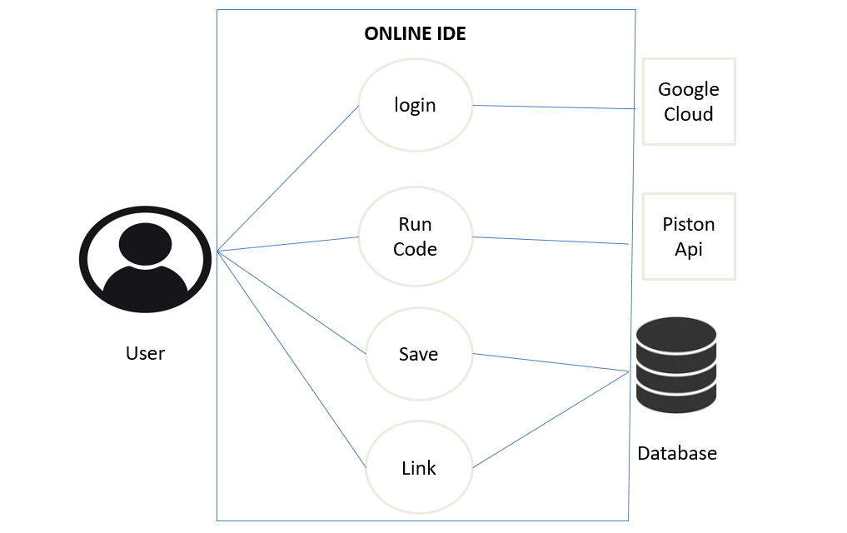
Proposed system architecture

Slide 16
Proposed Method
Our idea is to create a online IDE. Users can login in it using their google accounts. Here user is given a separate id. User need to select the language and type the code in the editor. After writing the code he can save the code or run the code. The code is saved in his account and he can view it whenever he login. If he run the code all these input is sent to piston api and piston api compiles the code and sends the output.

Slide 17
Comparison of Proposed system with an Existing system
EXISTING METHOD
Code Sharing not possible.
Can Compile only one
language.
Code cannot be saved.
Complicated Architecture
Less Secured.
PROPOSED METHOD
Code Sharing is possible.
Can Compile many
languages.
Code can be saved.
Simple Architecture.
More Secured.

Slide 18
Performance Measure

Slide 19
Performance Measure
Saved codes are stored in mongo dB database without any redundancy and latency.
The time taken for code compilation depends on band width.
The memory for link generation is handled efficiently.
Users can successfully login through their google accounts.

Slide 20
Result Analysis

Slide 21
Result Analysis
Many compilers and editors are developed by different platforms, but most of them have complicated architecture.
2. Different IDE's have different issues, some of them doesn't support complicated libraries, some of them cant store codes and sharing the code is difficult.
3. Our product can compile and save the code in the user profile. It have simple architecture.
4. It is more secured compared to ordinary Compilers.
5. We can share our code by link generated by server.

Slide 22
Conclusion

Slide 23
Conclusion
By using our IDE, there is no need to save code in different folder or files, codes are stored in user profile itself. Users feel this more secured and comfortable. It is authenticated using Google Auth. Our product won’t face any glitches or errors as it have simple architecture.

Slide 24
Future Work

Slide 25
As of now our compiler can compile only 5 language, further we will increase the number of languages.
Now our compiler can be used by competitive coders but in future we will can design in such a way that it can be used for web development.
Present we are dependent on piston api but further we will create own api so that we can reduce the dependency.
Future work

Slide 26
References

Slide 27
References
https://piston.readthedocs.io/en/latest/api-v2
https://google-auth.readthedocs.io/en/master/
https://github.com/engineer-man/piston
https://www.npmjs.com/package/google-auth-library
https://www.academia.edu/33264889
https://www.researchgate.net/publication/292869015

Slide 28


